Slide 1
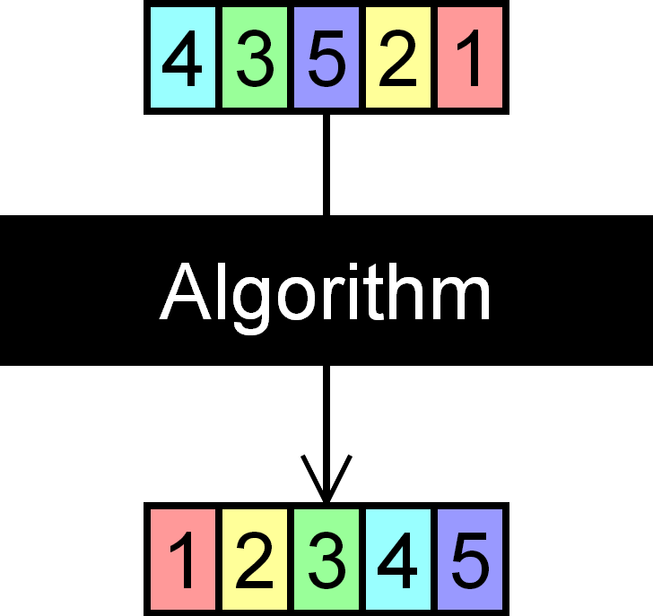
Sorting and Searching Algorithms
Simple and Advanced Sorting and Searching Algorithms
SoftUni Team
Technical Trainers
Software University
https://about.softuni.bg

Slide 2
Table of Contents
Simple Sorting Algorithms
Selection, Bubble Sort and Insertion
Advanced Sorting Algorithms
QuickSort, MergeSort
Choosing a Sorting Algorithm
Searching Algorithms
Linear Search
Binary Search
Interpolation Search
Shuffling
2
Notes:
2

Slide 3

Selection Sort and Bubble Sort

Slide 4
What is a Sorting Algorithm?
Sorting algorithm
An algorithm that rearranges elements in a list
In non-decreasing order
Elements must be comparable
More formally
The input is a sequence / list of elements
The output is a rearrangement / permutation of elements
In non-decreasing order

Slide 5

Sorting – Example
Efficient sorting algorithms are important for:
Producing human-readable output
Canonicalizing data – making data uniquely arranged
In conjunction with other algorithms, like binary searching
Example of sorting:
Unsorted list
sorting
Sorted list
10 | 3 | 7 | 3 | 4
3 | 3 | 4 | 7 | 10

Slide 6
Sorting Algorithms: Classification
Sorting algorithms are often classified by:
Computational complexity and memory usage
Worst, average and best-case behavior
Recursive / non-recursive
Stability – stable / unstable
Comparison-based sort / non-comparison based

Slide 7
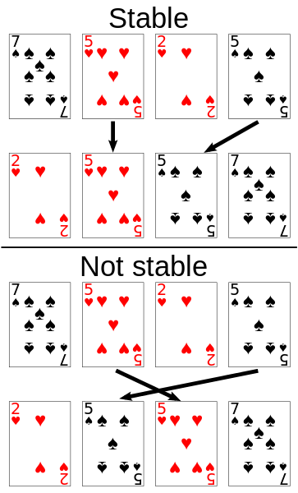
Stability of Sorting
Stable sorting algorithms
Maintain the order of equal elements
If two items compare as equal, their relative order is preserved
Unstable sorting algorithms
Rearrange the equal elements in unpredictable order
Often different elements have same key used for equality comparing

Slide 8
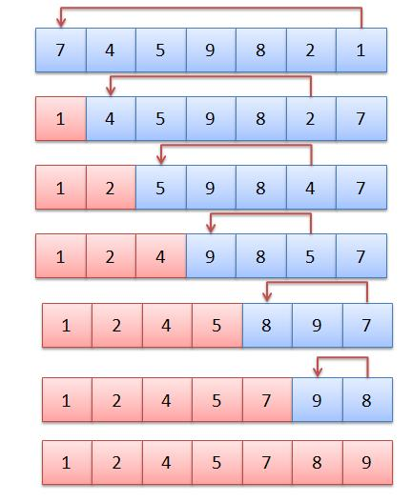

Selection Sort
Selection sort – simple, but inefficient algorithm
Swap the first with the min element on the right, then the second, etc.
Memory: O(1), Time: O(n²), Stable: No
Method: Selection
See the visualization: https://visualgo.net/en/sorting → choose Selection:
8

Slide 9

Selection Sort: Code
var nums = new[] { 1, 3, 4, 2, 5, 6 };
for (int start = 0; start < nums.Length - 1; start++)
{
// posМin is position of min, set to current array index
int posМin = start;
for (int next = start + 1; next < nums.Length; next++)
if (nums[next] < nums[posМin])
posМin = next;
// if posМin no longer equals i → a smaller value was found →
// a swap must occur
if (posМin != start)
Swap(nums, posМin, start);
}
Console.WriteLine(string.Join(" ", nums));
9

Slide 10
Swap Method: Code
Interchanging two elements (swap):
static void Swap(int[] nums, int index1, int index2)
{
int oldNum = nums[index1];
nums[index1] = nums[index2];
nums[index2] = oldNum;
}

Slide 11
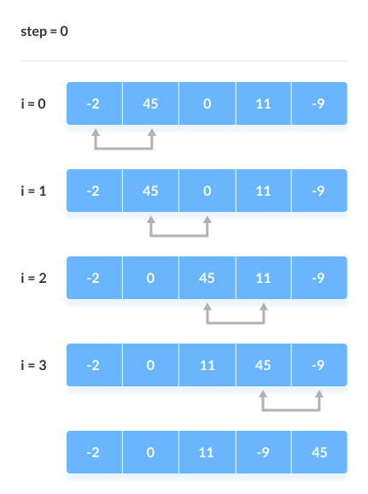
Bubble Sort
Bubble sort – simple, but inefficient algorithm
Swaps to neighbor elements when not in order until sorted
Memory: O(1), Time: O(n²), Stable: Yes
Method: Exchanging
See the visualization: https://visualgo.net/en/sorting → choose Bubble sort:
11

Slide 12
Bubble Sort: Code
var nums = new[] { 1, 3, 4, 2, 5, 6 };
for (int i = 0; i < nums.Length; i++)
{
for (int j = 1; j < nums.Length - i; j++)
{
if (nums[j - 1] > nums[j])
Swap(nums, j - 1, j);
}
}
Console.WriteLine(string.Join(" ", nums));

Slide 13
Comparison of Sorting Algorithms
Selection sort vs. Bubble sort:
Name | Best | Average | Worst | Memory | Stable | Method
Selection | n² | n² | n² | 1 | No | Selection
Bubble | n | n² | n² | 1 | Yes | Exchanging

Slide 14
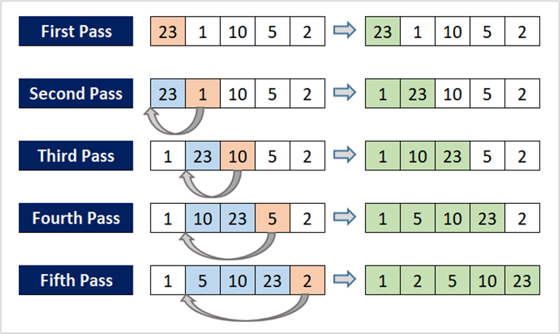
Insertion Sort
Insertion Sort – simple, but inefficient algorithm
Move the first unsorted element left to its place
Memory: O(1), Time: O(n²)
Stable: Yes
Method: Insertion
See the visualization: https://visualgo.net/en/sorting → choose Insertion sort:

Slide 15
Insertion Sort
var nums = new[] { 1, 3, 4, 2, 5, 6 };
for (int startIndex = 1; startIndex < nums.Length; startIndex++)
{
var currIndex = startIndex;
while (currIndex > 0 && nums[currIndex] < nums[currIndex - 1])
{
Swap(nums, currIndex, currIndex - 1);
currIndex--;
}
}
Console.WriteLine(string.Join(" ", nums));

Slide 16
Comparison of Sorting Algorithms
Selection sort vs. Bubble sort vs. Insertion sort:
Name | Best | Average | Worst | Memory | Stable | Method
Selection | n² | n² | n² | 1 | No | Selection
Bubble | n | n² | n² | 1 | Yes | Exchanging
Insertion | n | n² | n² | 1 | Yes | Insertion

Slide 17

QuickSort, MergeSort

Slide 18
Quick Sort
QuickSort – efficient sorting algorithm
Choose a pivot; move smaller elements left & larger right; sort left & right
Memory: O(log(n)) stack space (recursion), Time: O(n²), Stable: Depends
Method: Partitioning
See the visualization: https://visualgo.net/en/sorting → choose Quick sort:
18

Slide 19
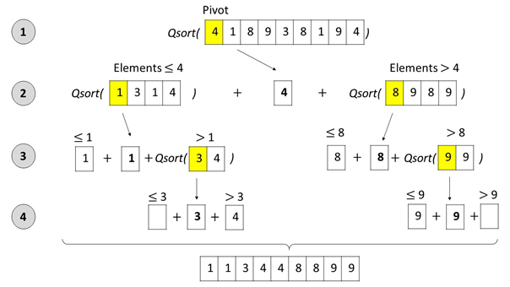
Quick Sort: Conceptual Overview
19

Slide 20
Comparison of Sorting Algorithms
Selection sort vs. Bubble sort vs. Insertion sort vs. Quick sort:
Name | Best | Average | Worst | Memory | Stable | Method
Selection | n² | n² | n² | 1 | No | Selection
Bubble | n | n² | n² | 1 | Yes | Exchanging
Insertion | n | n² | n² | 1 | Yes | Insertion
Quick | n * log(n) | n * log(n) | n² | 1 | Depends | Partitioning

Slide 21
Merge Sort
Merge sort is efficient sorting algorithm
Divide the list into sub-lists (typically 2 sub-lists)
Sort each sub-list (recursively call merge-sort)
Merge the sorted sub-lists into a single list
Memory: O(n) / O(n*log(n)), Time: O(n*log(n)), Stable: Yes
Highly parallelizable on multiple cores → up to O(log(n))
See the visualization: https://visualgo.net/en/sorting → choose Merge sort:
21

Slide 22
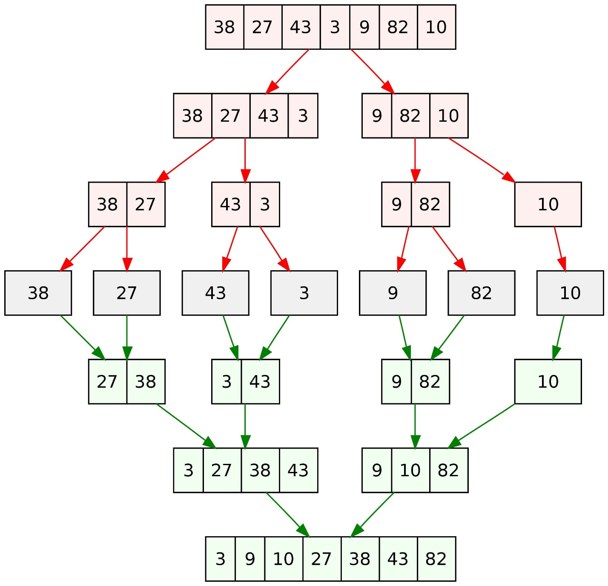
Merge Sort: Conceptual Overview
22

Slide 23
Comparison of Sorting Algorithms
Selection sort vs. Bubble sort vs. Insertion sort vs. Quick sort vs. Merge sort:
Additional algorithms comparison: https://www.toptal.com/developers/sorting-algorithms
Name | Best | Average | Worst | Memory | Stable | Method
Selection | n² | n² | n² | 1 | No | Selection
Bubble | n | n² | n² | 1 | Yes | Exchanging
Insertion | n | n² | n² | 1 | Yes | Insertion
Quick | n * log(n) | n * log(n) | n² | 1 | Depends | Partitioning
Merge | n * log(n) | n * log(n) | n * log(n) | 1 | Yes | Merging

Slide 24
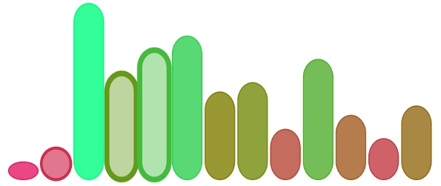
Built-in and Special Algorithms

Slide 25
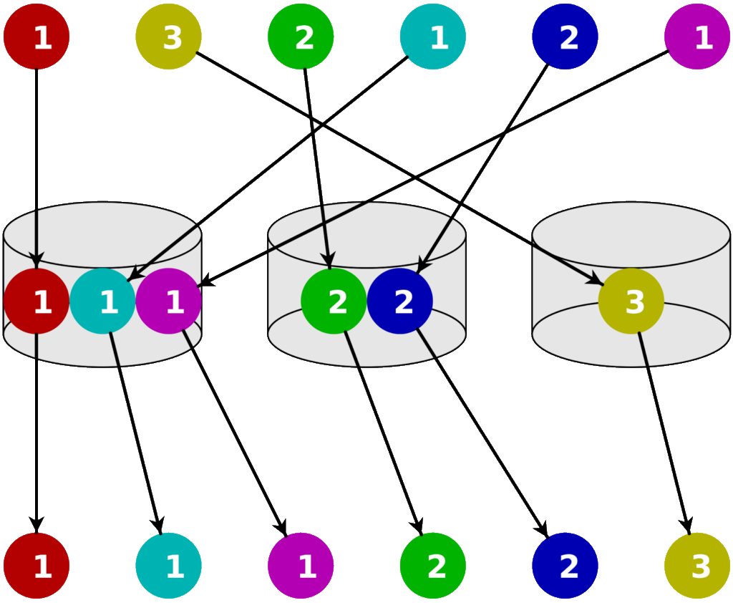
How to Choose a Sorting Algorithm
Use Insertion sort for small and QuickSort for larger arrays
Use the built-in sorting from C# / .NET
Array.Sort()
List<T>.Sort()
Other built-in sorting
Use special sorting in special cases:
Example: Bucket sort (runs in linear time)
See the visualization: http://www.algostructure.com/sorting/bucketsort.php

Slide 26


Linear, Binary and Interpolation Search

Slide 27

Search Algorithm
Search algorithm == an algorithm for finding an item with specified properties among a collection of items
Different types of searching algorithms:
For virtual search spaces
Satisfy specific mathematical equations
Try to exploit partial knowledge about a structure
For sub-structures of a given structure
A graph, a string, a finite group
Search for the min / max of a function, etc.

Slide 28
Linear Search
Linear search finds a particular value in a list
Checking every one of the elements
One at a time, in sequence
Until the desired one is found
Worst & average performance: O(n)
See the visualization
for each item in the list:
if that item has the desired value,
return the item's location
return nothing

Slide 29
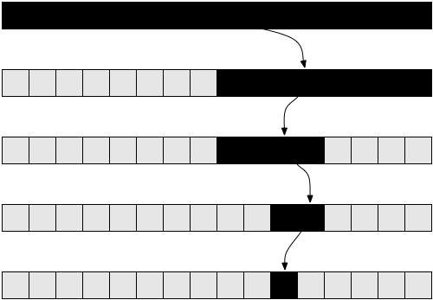
Binary Search
Binary search finds an item within an ordered data structure
At each step, compare the input with the middle element
The algorithm repeats its action to the left or right sub-structure
Average performance: O(log(n))
See the visualization
29

Slide 30
Binary Search (Iterative): Code
static int BinarySearch(int[] numbers, int searchNumber) {
var left = 0;
var right = numbers.Length - 1;
while (left <= right) {
var mid = (left + right) / 2;
if (numbers[mid] == searchNumber)
return mid;
if (searchNumber > numbers[mid])
left = mid + 1;
else
right = mid - 1;
}
return KEY_NOT_FOUND; // const KEY_NOT_FOUND = -1;
}

Slide 31
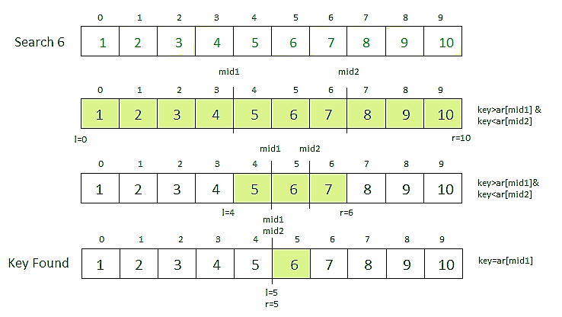
Interpolation Search
Interpolation search == an algorithm for searching for a given key in an ordered indexed array
Similar to how humans search through a telephone book
Calculates where in the remaining search space the item may be
Binary search always chooses the middle element
Average case: log(log(n))
Worst case: O(n)
See the visualization
31

Slide 32
Interpolation Search: Code
int InterpolationSearch(int[] sortedArray, int key) {
int low = 0;
int high = sortedArray.Length - 1;
while (sortedArray[low] <= key && sortedArray[high] >= key) {
int mid = low + ((key - sortedArray[low]) * (high - low))
/ (sortedArray[high] - sortedArray[low]);
if (sortedArray[mid] < key)
low = mid + 1;
else if (sortedArray[mid] > key)
high = mid - 1;
else
return mid;
}
if (sortedArray[low] == key) return low;
else return KEY_NOT_FOUND; // const KEY_NOT_FOUND = -1;
}

Slide 33

Fisher-Yates Shuffle

Slide 34
Shuffling
Shuffling == randomizing the order of items in a collection
Generate a random permutation
"The generation of random numbers is too important to be left to chance."
—Robert R. Coveyou
A
B
C
D
D
B
A
C
Input: arr[], holding n elements
Shuffle: for i = 0 … n:
next = random in the range [i … n-1]
Exchange(arr[i], arr[next])

Slide 35
Fisher–Yates Shuffle Algorithm: Code
public static void Shuffle(T[] elements)
{
Random rnd = new Random();
for (int i = 0; i < elements.Length; i++)
{
// Exchange array[i] with random element in array[i … n-1]
int next = rnd.Next(i, elements.Length);
T oldElement = elements[i];
elements[i] = elements[next];
elements[next] = oldElement;
}
}
Shuffle algorithms: visualization

Slide 36
Summary
Slow sorting algorithms:
Selection sort, Bubble sort, Insertion sort
Fast sorting algorithms:
Quick sort, Merge sort, Bucket sort, etc.
Searching algorithms
Binary Search, Linear Search, Interpolation Search
Shuffling
Randomizing the order of items in a collection
Fisher-Yates Shuffle
Notes:
36

Slide 37
Questions?
Notes:
37

Slide 38

License
This course (slides, examples, demos, exercises, homework, documents, videos and other assets) is copyrighted content
Unauthorized copy, reproduction or use is illegal
© SoftUni – https://softuni.org
© Software University – https://softuni.bg
Notes:
38

Slide 39
Trainings @ Software University (SoftUni)
Software University – High-Quality Education, Profession and Job for Software Developers
softuni.bg, softuni.org
Software University Foundation
softuni.foundation
Software University @ Facebook
facebook.com/SoftwareUniversity
Software University Forums
forum.softuni.bg
39
Notes:
39

